Slide 1


Credit Card Fraud Prediction Application User Guide
Author: Ciaran Finnegan / DBS Student No. : 10524150
March 2019 Intake – Fri/Sat
E-mail: 10524150@mydbs.ie / ciaran@feefinnegan.com
Higher Diploma in Science in Data Analytics – B8IT110 Final Project

Slide 2

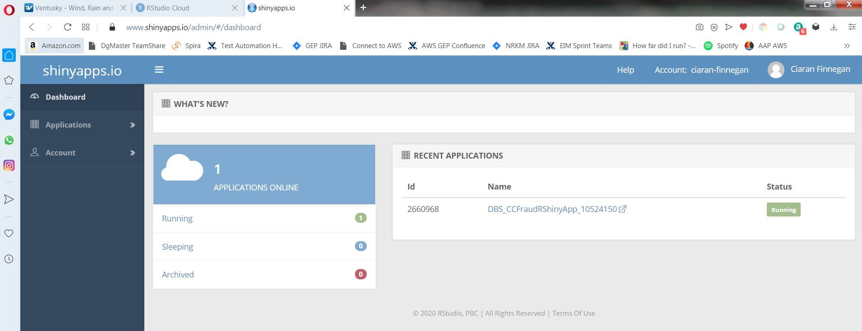
Credit card fraud prediction - UI
The application front end is a hosted Shiny R application dashboard.
To access..
https://ciaran-finnegan.shinyapps.io/DBS_CCFraudRShinyApp_10524150/

Slide 3

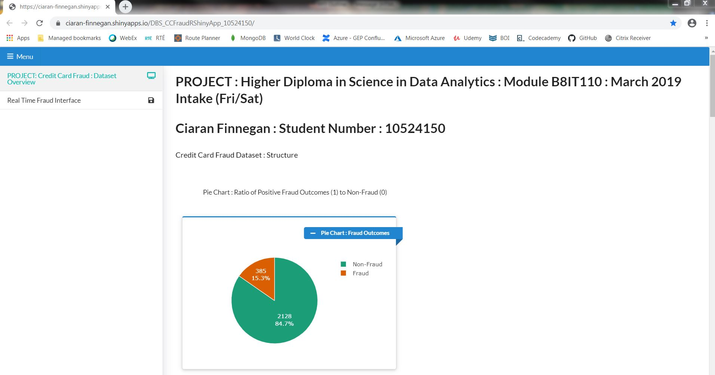

CC Fraud Dashboard
The project application interface is a Shiny R dashboard with two tabs.
One for data visualisation on CC fraud dataset used for model creation
The other to provide an interface to check ‘new’ loaded cc trxns for fraud.

Slide 4
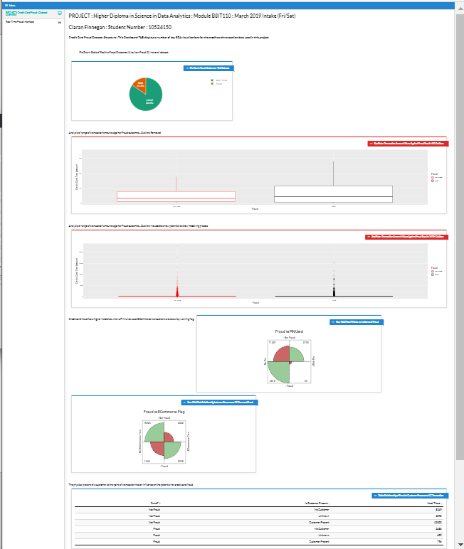
CC Fraud Dashboard
Visualisations Tab (1)
The application uses all the 25K dataset rows for visualisations.
This is the dataset used in training and deploying the production predictive model in Azure.
The first tab on the dashboard contains a series of graphs that visualise key aspects of the credit card fraud dataset.

Slide 5
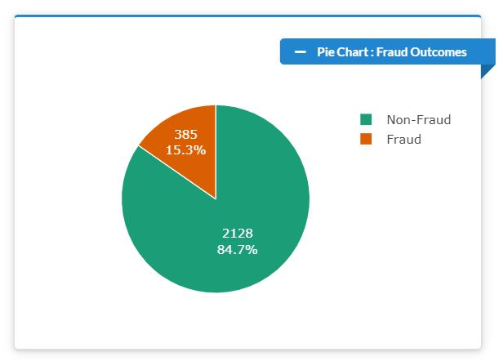
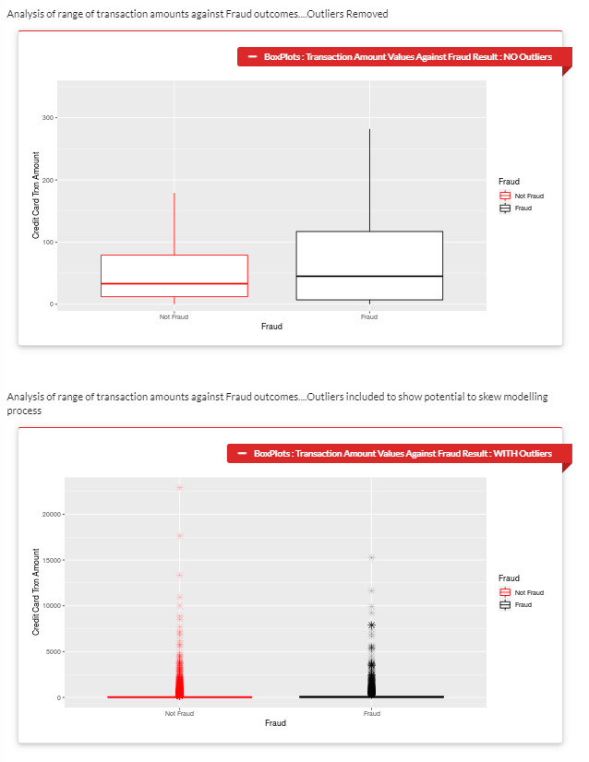
CC Fraud Dashboard
Visualisations (2) –
The first graph shows a pie chart of the breakdown of Fraud/Non-Fraud records in the dataset.
The next two are box plots of the analysis of fraud based on the dollar ($) amounts of the credit card transactions.

Slide 6
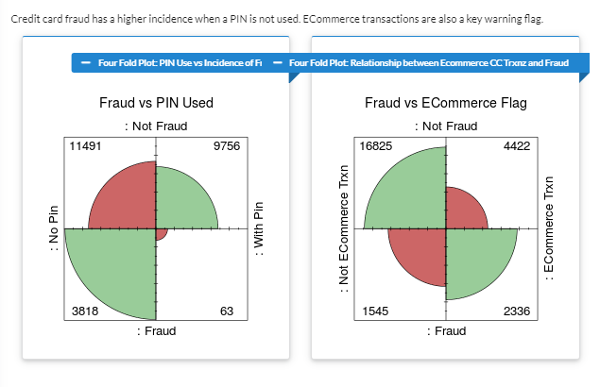
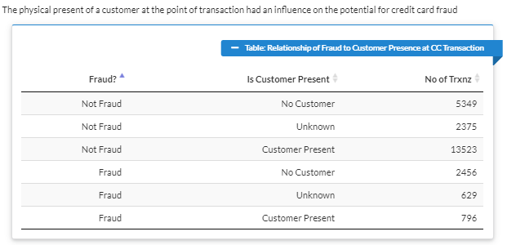
CC Fraud Dashboard
Visualisations (3) –
Two more graphs display a Four Fold Plot analysis of how ‘PIN Used’ and ‘ECommerce Flag’ relate to incidents of fraud.
A tabular view displays an analysis of how ‘Customer Presence’ relates to fraud incidences.

Slide 7
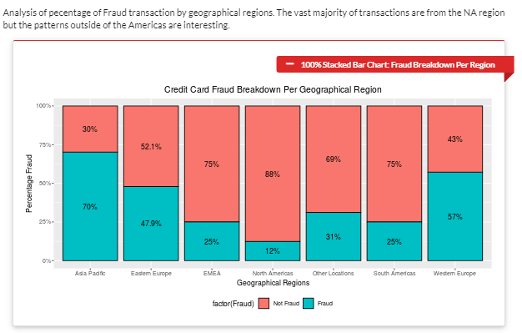
CC Fraud Dashboard
Visualisations (4) –
The last graph is a 100% Stacked Bar Chart that displays how the proportion of fraudulent transactions varies across different geographical regions. (The vast majority of transactions in the dataset are from Canada and the United States but this remains an interesting analysis of international patterns).

Slide 8

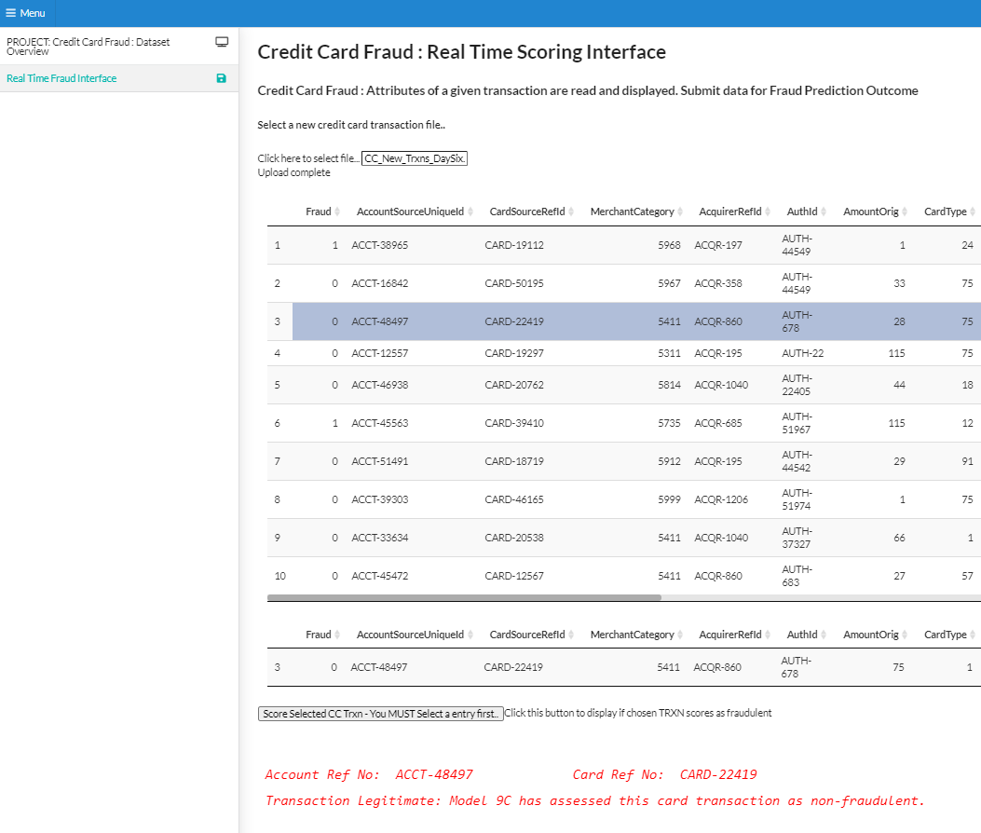

Fraud ‘ Production’ Interface (1)
The second tab has a basic workflow for checking a given credit card transaction for suspected fraud.
This tab allows the user to:
Load .csv files that contain ‘new’ credit card transactions.
Display the individual records stored in these .csv files.
Select a single record and invoke the API to the Azure hosted predictive fraud model.
Obtain a result in real time from the production model that indicates if the chosen transaction is likely to be fraudulent.

Slide 9
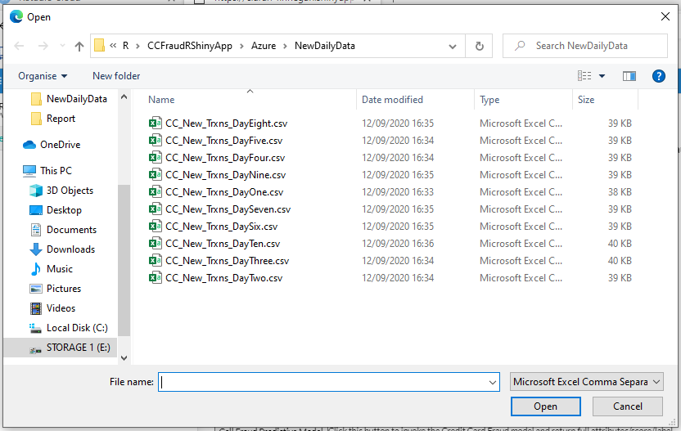
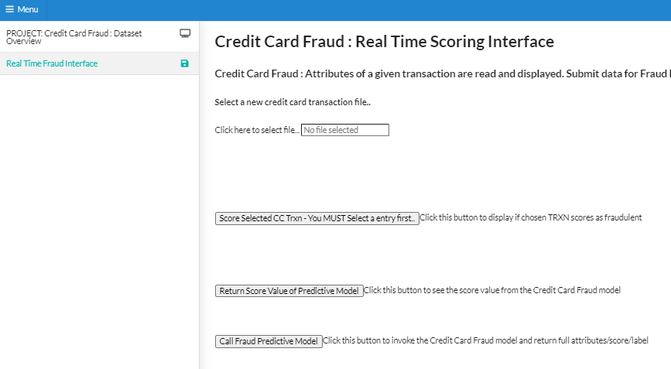

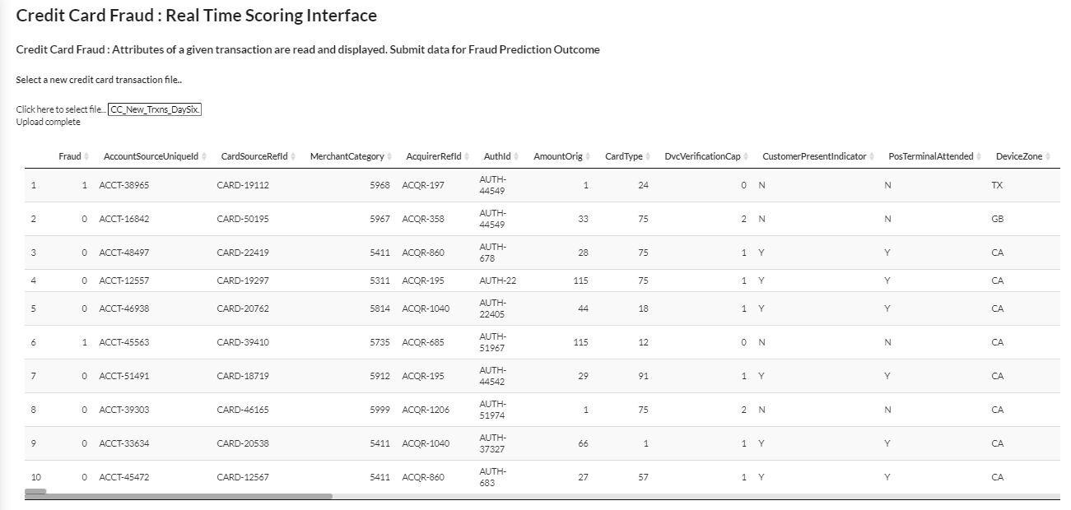
Fraud ‘ Production’ Interface (2)
The second tab is empty when the application first opens.
The user must select a file of ‘new’ transaction. This will populate the first section in the tab.
Chose a file to open..
Click here to select transaction files..

Slide 10
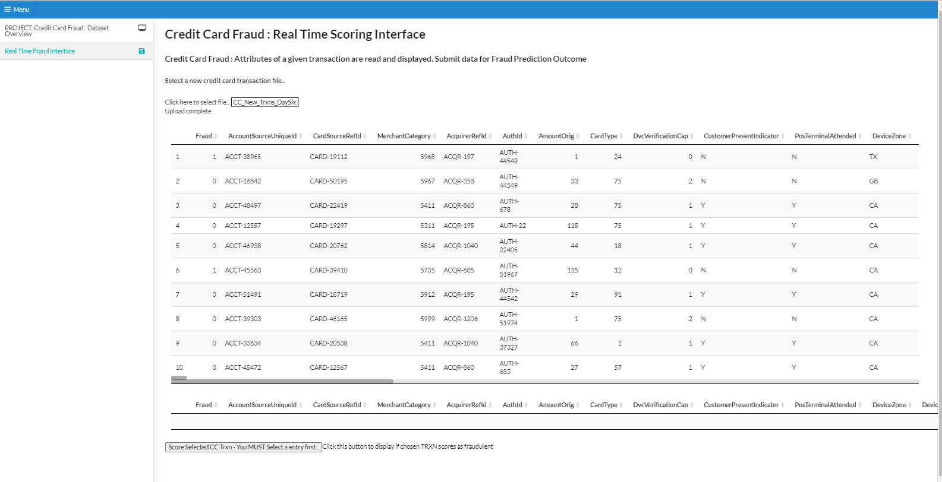
Fraud ‘ Production’ Interface (3)
Transactions are read from the CSV file to populate the upper table area on the tab.
(The ‘Fraud’ label comes from the dataset. It is kept for illustration purposes, but it is not used in when the scoring model is invoked).
The screen loads with a set of ten ‘new’ transactions

Slide 11
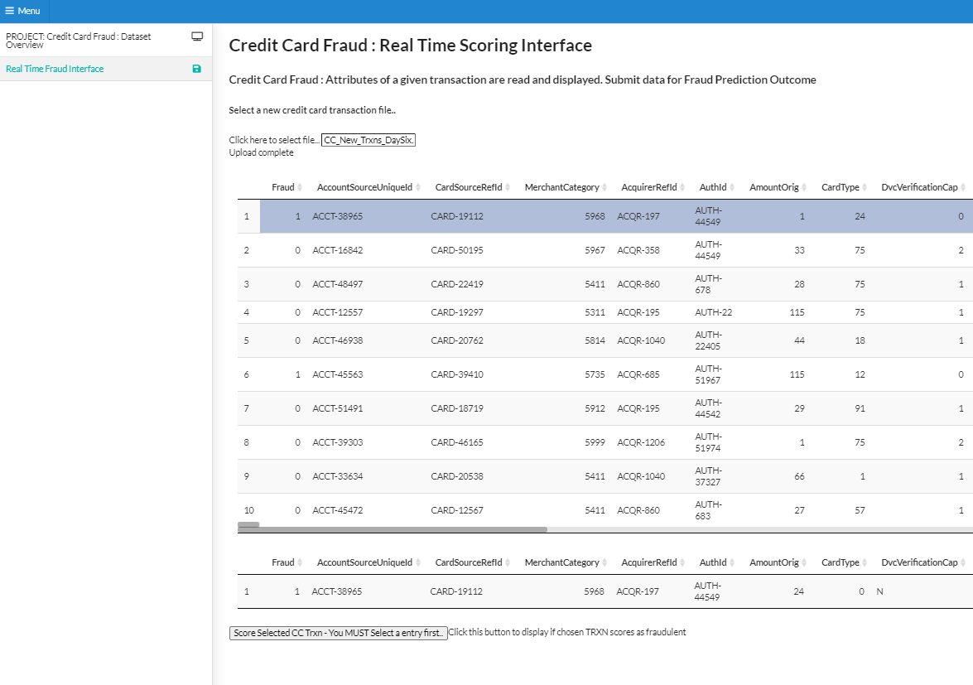
Fraud ‘ Production’ Interface (4)
The user must select a single transaction to populate the ‘selection’ data table.
A record has been successfully chosen if it is replicated in this data table

Slide 12
Fraud ‘ Production’ Interface (5)
The score the transaction and get a prediction about whether it is fraudulent, click this button

Slide 13
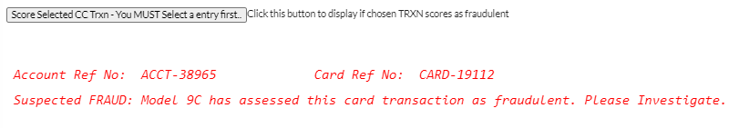
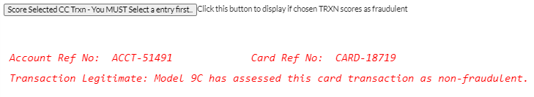
Fraud ‘ Production’ Interface (6)
An API is invoked with the attributes of the chosen transaction and the Azure hosted model returns a simple message indicating Fraud (or not).

Slide 14
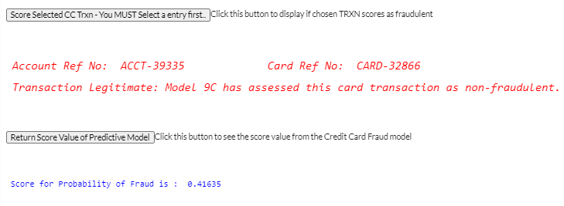
Fraud ‘ Production’ Interface (7)
In addition, the API for fraud prediction can be invoked by a separate button to show the actual predictive score from the Logistic Regression Classification model.
<0.5 = Non-Fraud
>0.5 = Fraud

Slide 15
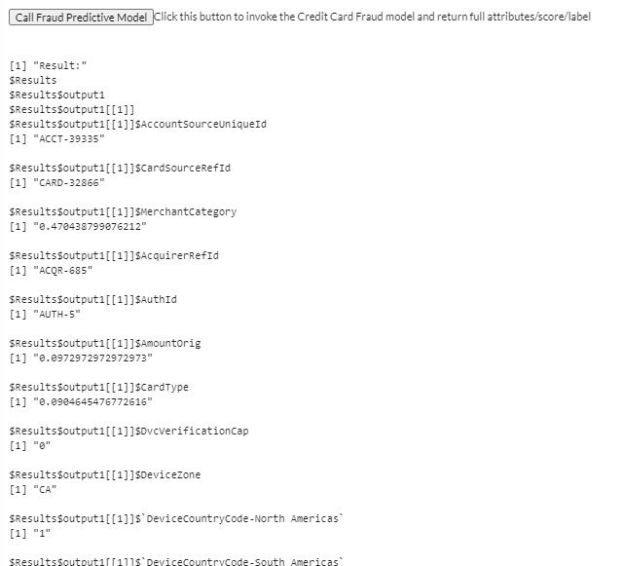
Fraud ‘ Production’ Interface (8)
The lowest button on the tab will return the full output from the Azure hosted predictive model.

